Slide 1
NAPEF 2023
Welcome to the Annual Meeting

Slide 2
NAPEF Created by Resolution to Assembly in 1983.
NAPEF was created in 1983 by action of the Biennial Convention of the National Association of Parliamentarians to provide assistance to NAP in developing, promoting, and providing parliamentary procedure educational content, material, scholarships and program.
Since then, NAPEF has donated nearly $800,000 to NAP.

Slide 3
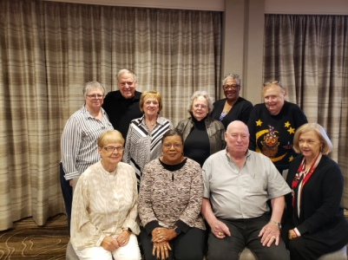
Trustees
2022-2023

Slide 4
Trustees:
Sandy Olson, PRP, President
Ann Guiberson, PRP, Vice-President
Alison Wallis, PRP, Secretary
Ron Stinson, PRP, Treasurer
Linda Lawson, Trustee
Nancy Sylvester, PRP, Trustee
Wanda Sims, PRP, NAP Liaison
Carl Silverman, PRP, Grant Chairman
Ramona Hill, PRP, Webmaster
Carol Habgood, PRP, Scholarship Chairman
Cyndy Launchbaugh, Adviser

Slide 5
Life Contributors

Slide 6
History
An excerpt from Exhibit B minutes of 11/11/85.
“Our goal is to earn interest on the
investments of contributions that
will be used to promote the
educational purposes of NAP
and thus alleviate the financial
strain on NAP.”
Incorporated in 1984
Assets $8,349.54;
Income $4,774.73;
Expenses: $3,274.02.
Grant to NAP: $475.00.

Slide 7
Partnership Agreement 2022
$15,000 annually to NAP Educational Development
$5,000 annually to NAP Educational endeavors and opportunities like the NAP Spring Conference and NAP University

Slide 8
Vision Statement
NAPEF is the leader in supporting superior parliamentary procedure educational programs and resources.

Slide 9
NAPEF MISSION
NAPEF supports the National Association of Parliamentarians and others by funding educational programs and resources that empower everyone to have efficient, effective, and fair meetings.

Slide 10
Partnership with NAP

Slide 11
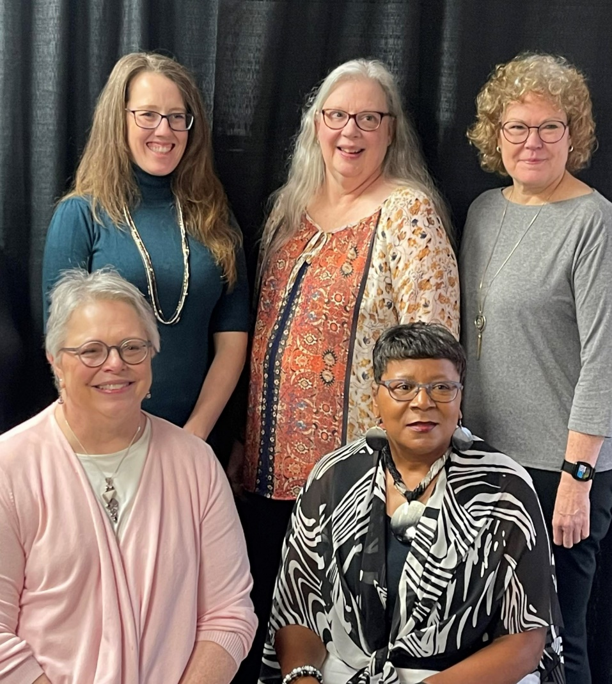
Cyndy Launchbaugh and Staff—Thank you!

Slide 12
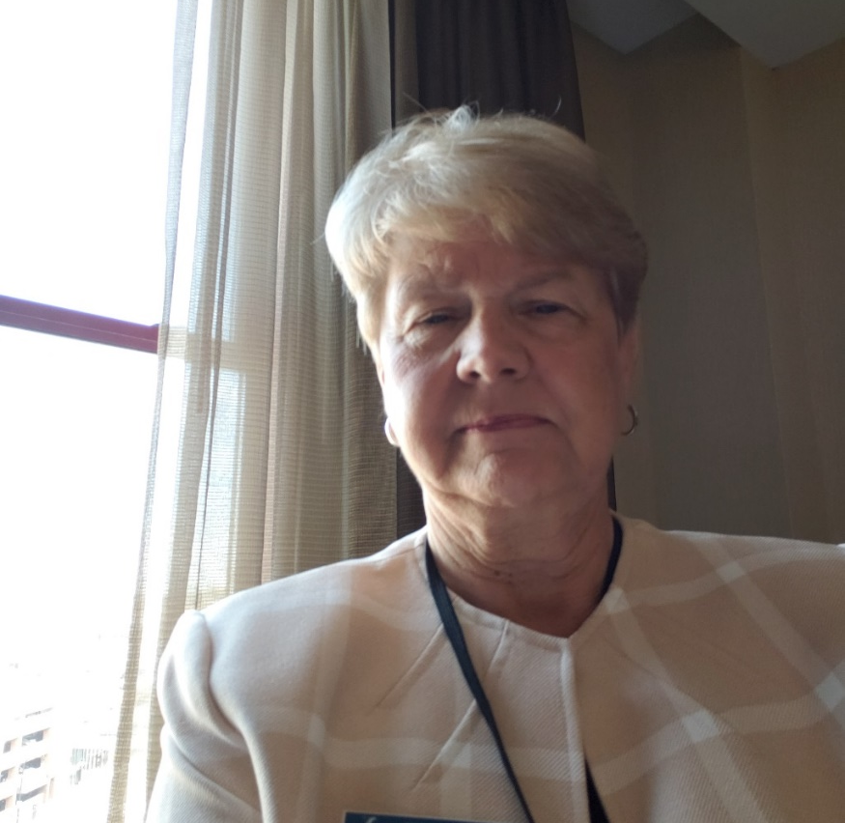
President’s Report
Prepared the agenda and chaired all meetings
Contributed and worked with fundraising committee to promote annual event and online book auction
Served on the investment, grants, planned giving, and fundraising committees
Worked to promote learning labs for Presiding and Parliamentarian
Thank you for your support and encouragement during these many years

Slide 13
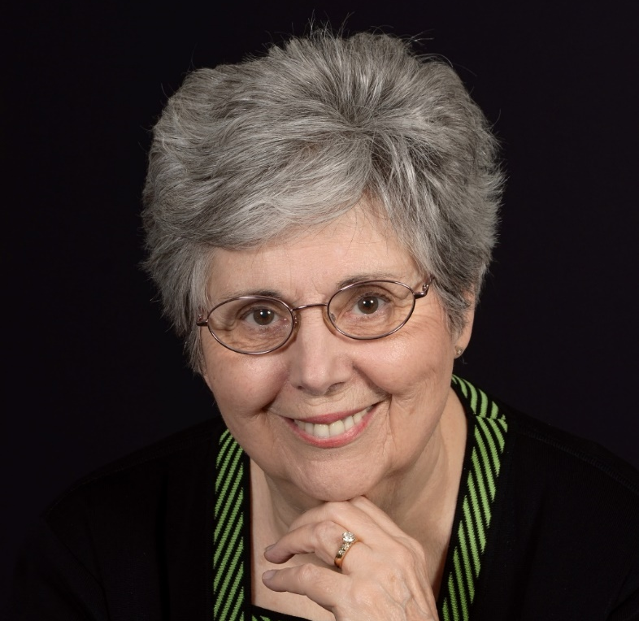
Vice President’s Report
Attended board meetings.
Assisted the President as needed.
Served on the finance committee
Served as chair of Contributorship and Fundraising Committee
Thank you for the opportunity to serve.

Slide 14
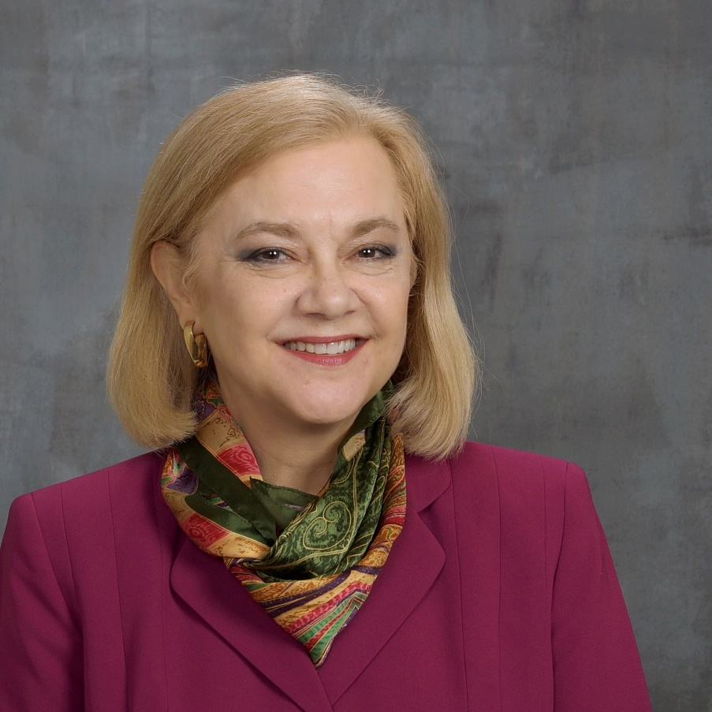
Secretary’s Report
Took notes at meetings
Promptly wrote the minutes and provided them to the trustees.
Attended all meetings.

Slide 15
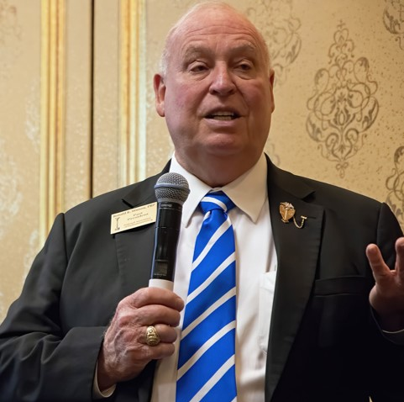
Treasurer’s Report
Audit Report and 990 filed and provided documentation
Current funds, checking, savings, investments
Served as chairman of the investments committee and assisted the audit committee
Chairman of Planned Giving

Slide 16
Planned Giving
1. IRA Required Minimum Distribution: The donor may designate NAPEF to receive the RMD. The benefit to the donor is that the contribution is nontaxable. The donor contacts the financial institution that administers the IRA to arrange the distribution of the RMD to NAPEF.
2. Wills/Trusts: Donors may contribute to NAPEF through a provision in their wills or trusts, or through amendments or codicils to those documents.
3. Investment Gifts: Individuals may donate securities to NAPEF. That provides a tax benefit to the donors. The donors would contact their investment advisor to arrange these actions.
4. Designation of Beneficiary on Financial Accounts: Members may designate NAPEF to receive funds “Payable on Death” on financial accounts, such as checking or savings accounts. Members would contact their financial institution to make the designation.
5. Life Insurance Proceeds: Members would contact their insurance agent to designate NAPEF as the beneficiary on an insurance policy.

Slide 17
Planned Giving
1. IRA Required Minimum Distribution: Designate the RMD to NAPEF.
2. Wills/Trusts: Contribute to NAPEF through a wills or trusts
3. Investment Gifts: Donate securities to NAPEF.
4. Designation of Beneficiary on Financial Accounts: Designate NAPEF to receive funds “Payable on Death”
5. Life Insurance Proceeds: Designate NAPEF as beneficiary

Slide 18
Carl Silverman, Chair
Grants Committee
San Antonio, Texas Parliamentary Institute $2,000
Jack and Jill of America, Orlando Chapter
$1990
Developed new grant application and rubric

Slide 19
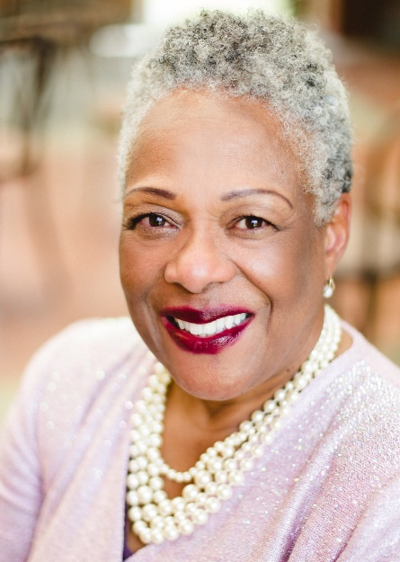
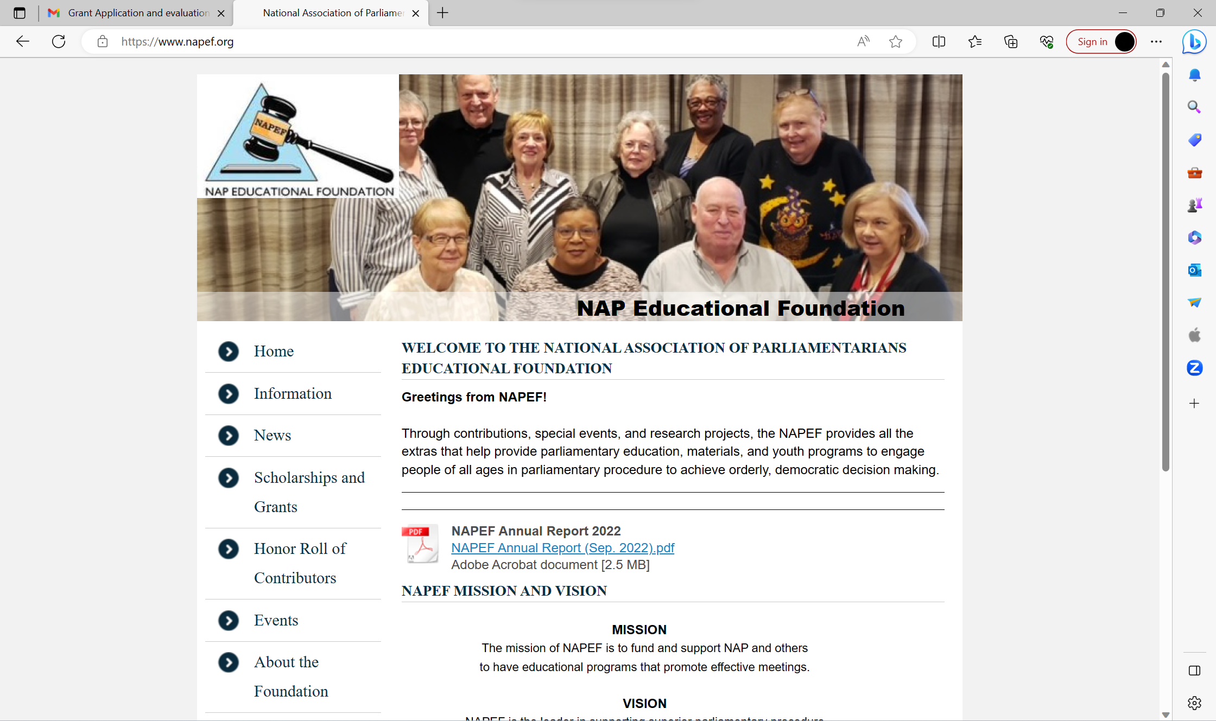
Webmaster Ramona Hill
Website: www.napef.org
E-Blast

Slide 20
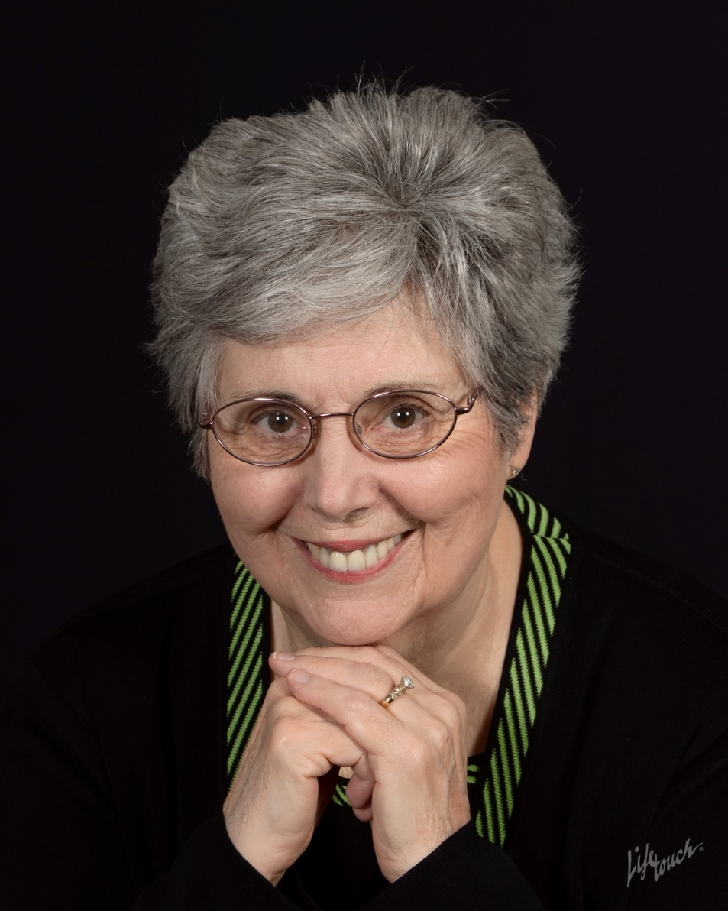
Fundraising and Contributions Chairman Ann Guiberson
Virtual Online Auction
Contributor Recognition
Adventures--Ballgame

Slide 21
Online Book Auction

Slide 22
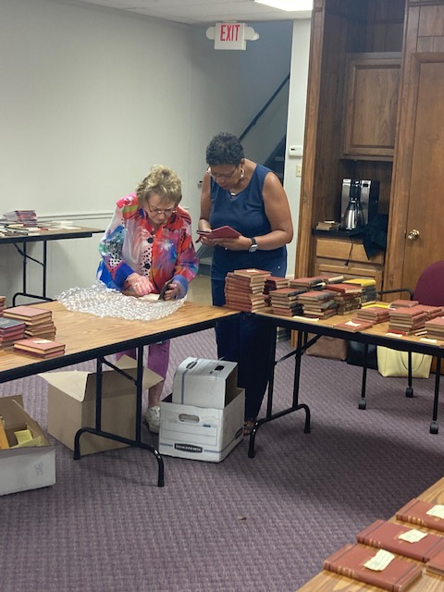
Online Book Auction 2023

Slide 23
Join the Adventure

Slide 24
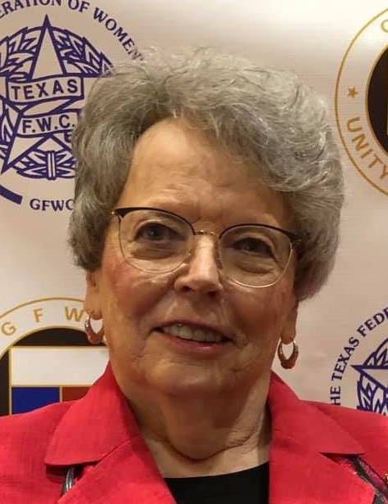
Carol Habgood, Chair
Scholarship Committee
Alice Ragona Memorial Scholarship
Young Professional Scholarship
Student Intern Scholarship
Viola Brannen Memorial Scholarship for Travel
Carol Habgood, Chair
Scholarship Committee

Slide 25
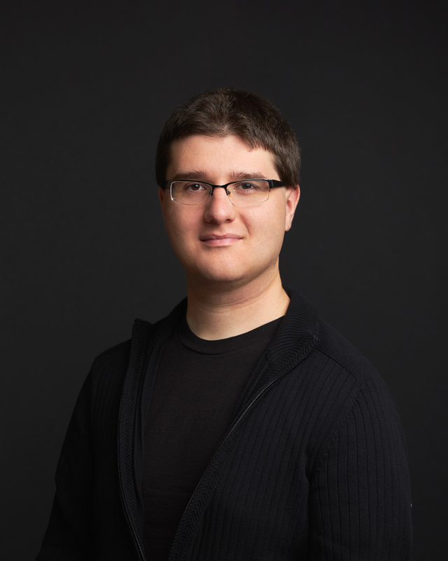
Congratulations, Peter Klapes
2023 NAP dues scholarship winner

Slide 26
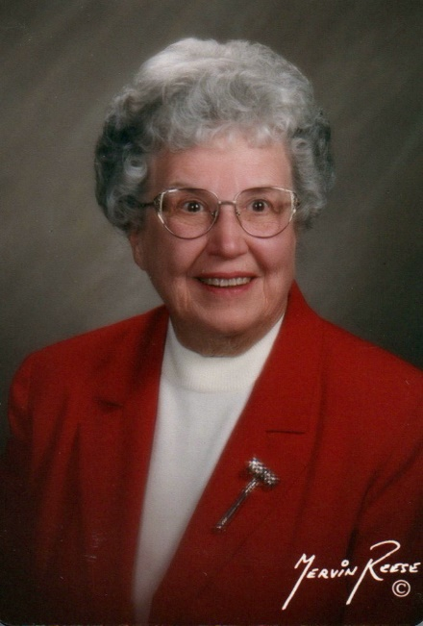
NEW Viola Brannen Memorial Scholarship
To attend in person the NAP National Training Conference or the NAP Biennial Convention
Awarded to member who has been a member of NAP for at least one year and who plans to attend the NTC or Biennial Convention in person
2 scholarships will be awarded annually—August 1 deadline

Slide 27
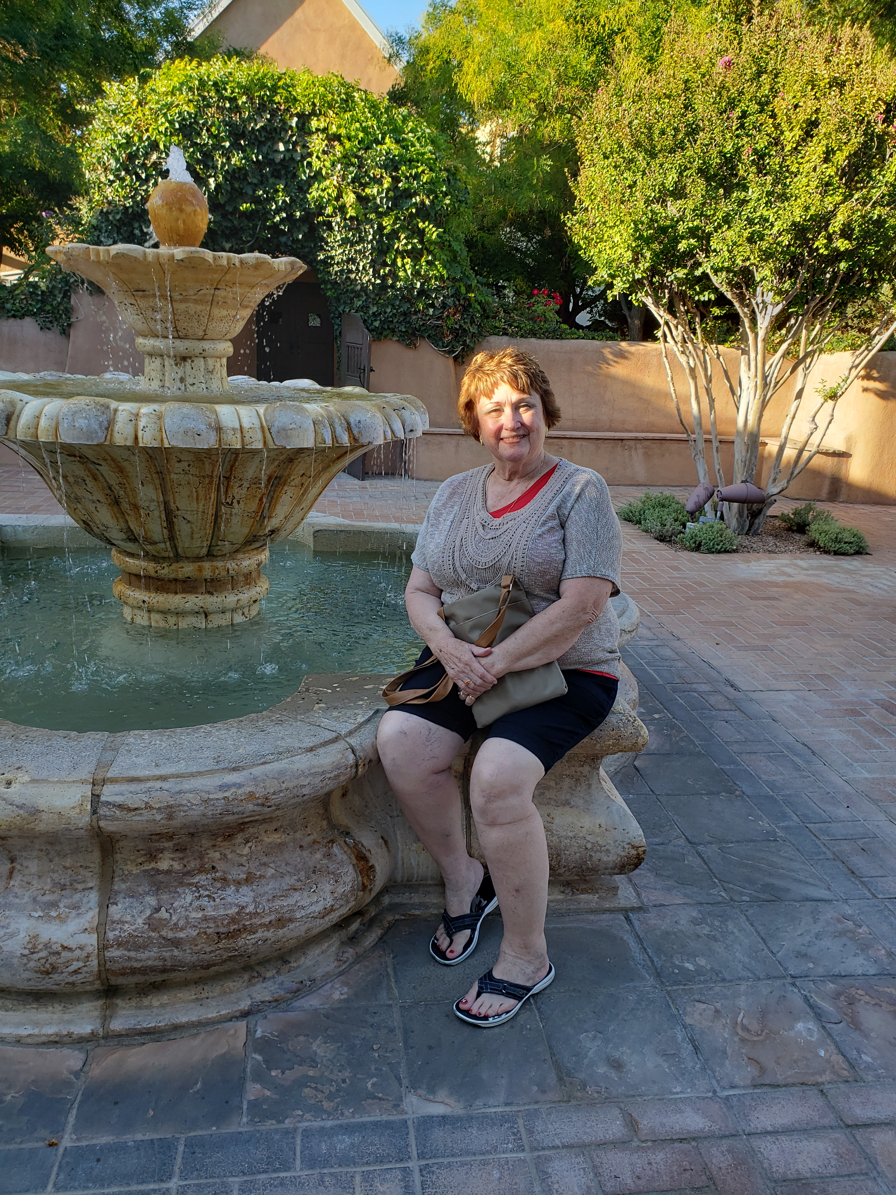
Viola Brannen Scholarship Winner 2023
Congratulations,
Lynna Gene Cook, PRP
Lincoln, Nebraska
Dr. Todd Ellis
Kalamazoo, Michigan

Slide 28
Contributorship
-
Supporters
Friends
Double Diamond
Diamond Ruby
Diamond Sapphire
New Levels:
Platinum--$30,000
Titanium--$50,000

Slide 29
New Platinum Contributor

Slide 30
Contributors Who Changed to New Levels:
Willie Evans - Life
Ann Guiberson - Diamond Sapphire
Mary Messerschmidt – Diamond Ruby
Rollie Cox - Diamond Diamond
Jim Lawson - Diamond Diamond
Carol Habgood - Platinum

Slide 31
NAPEF: Looking to the Future

